Slide 1


A.O.K. Laptop Overhaul System
Deliverable 3& 4
Data Modeling
and Starting Design
Course Project for: IS 436 Structured Systems Analysis and Design
Presented By:
Nima Roomi, Upen Adhikari, Omar Al-Hedari, Alex Varghese,Ralu Ofoche

Slide 2
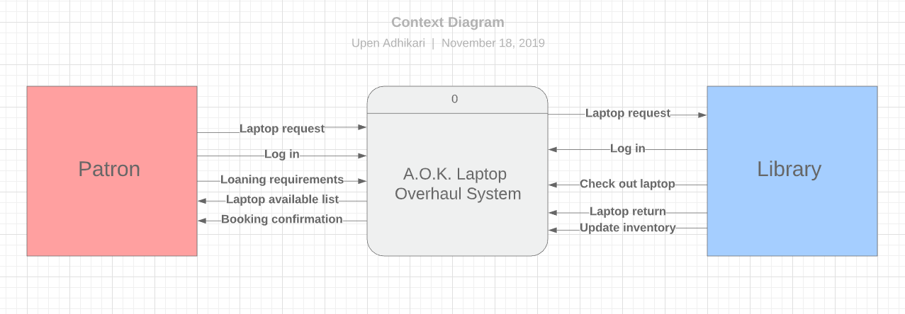
Context Diagram

Slide 3
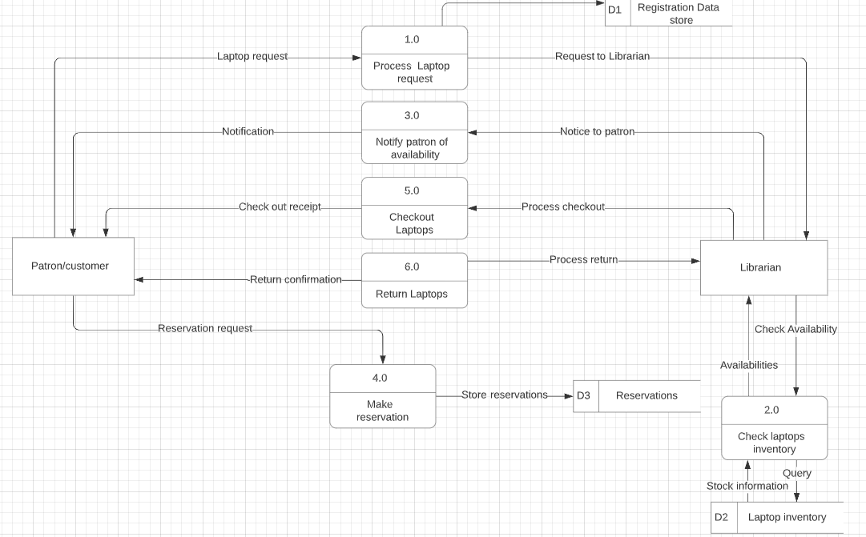
Level 0 Diagram

Slide 4
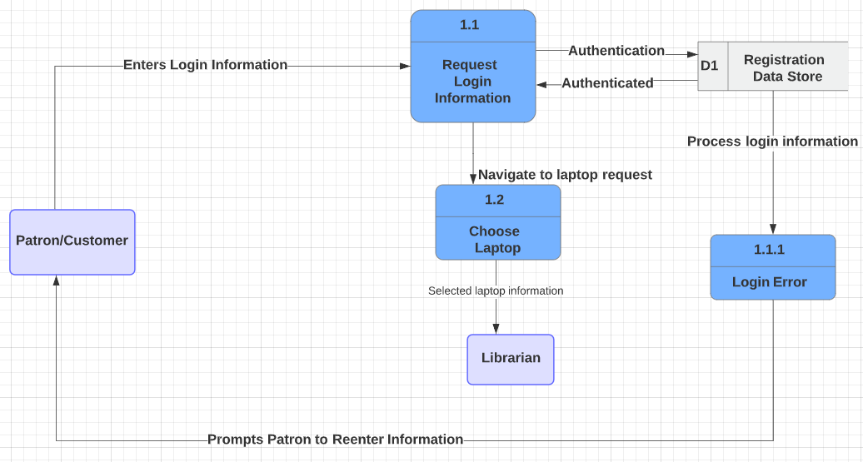
Level 1 Diagram - Process Laptop Request

Slide 5
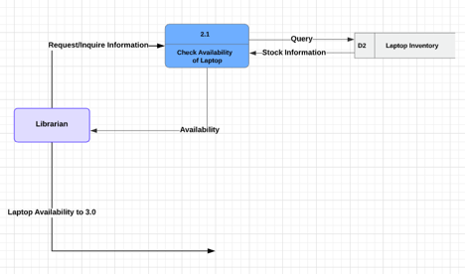
Level 2 Diagram - Check Laptop Inventory

Slide 6
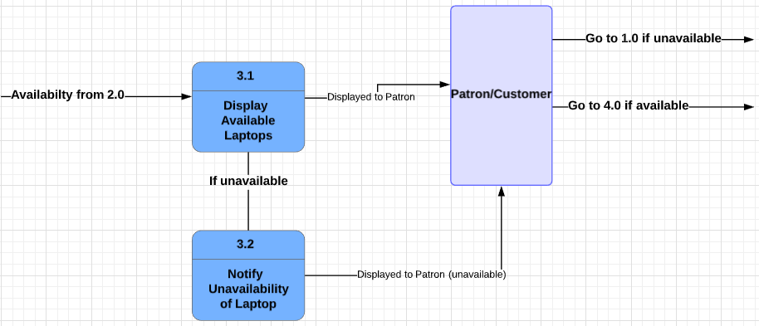
Level 3 Diagram - Notify Patron of Availability

Slide 7
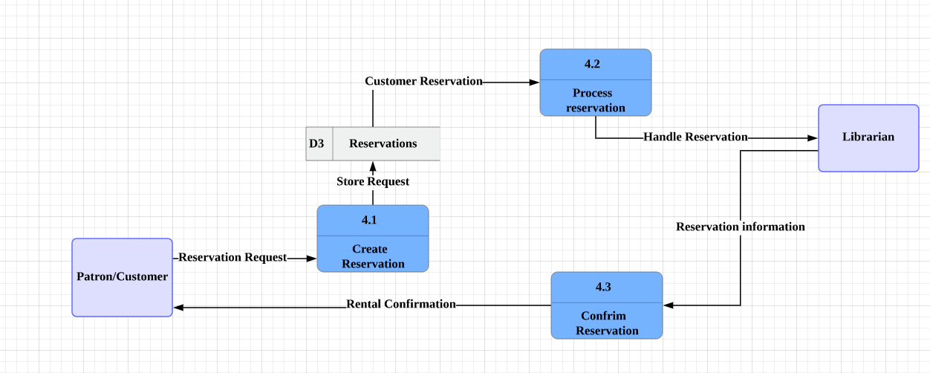
Level 4 Diagram - Make Reservation

Slide 8
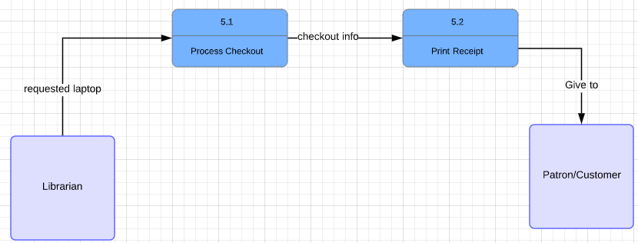
Level 5 Diagram - Checkout Laptop

Slide 9
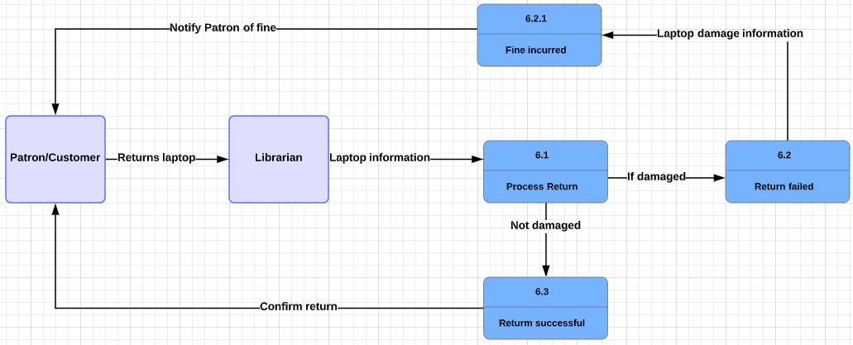
Level 6 Diagram Return Laptop

Slide 10
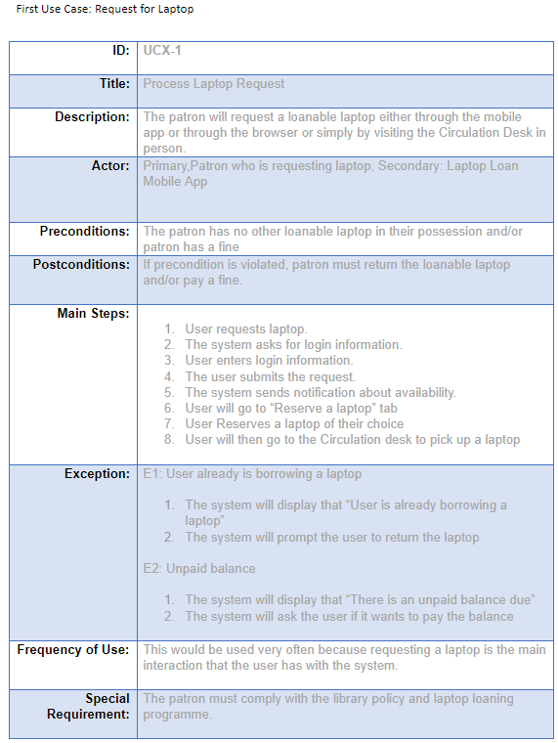
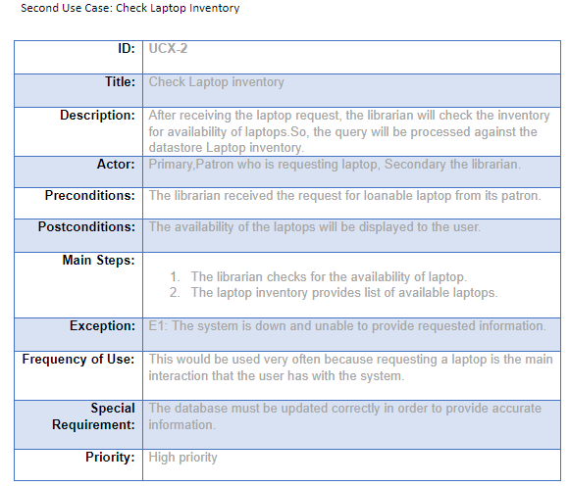
Use Cases(Request for Laptop/Check LaptopINV)

Slide 11
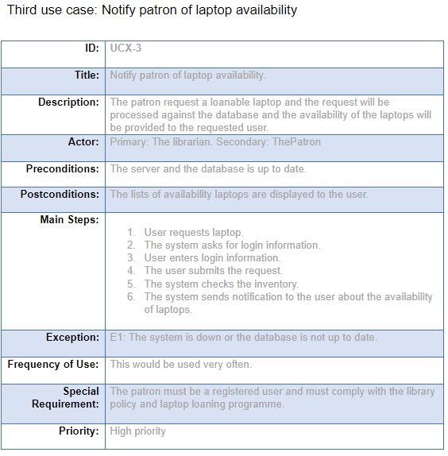
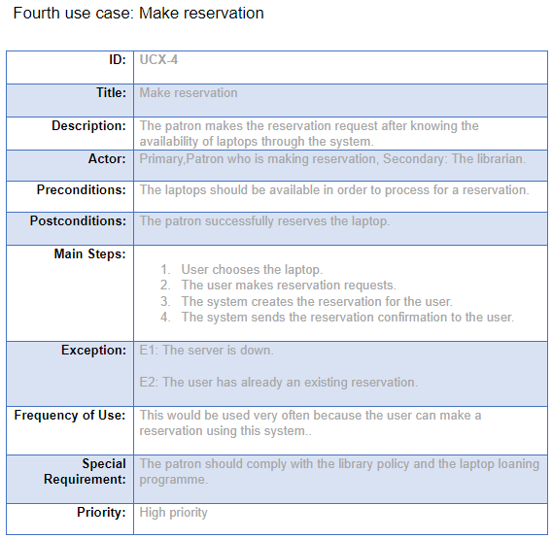
Use Case(Notify Patron/Make Reservation)

Slide 12
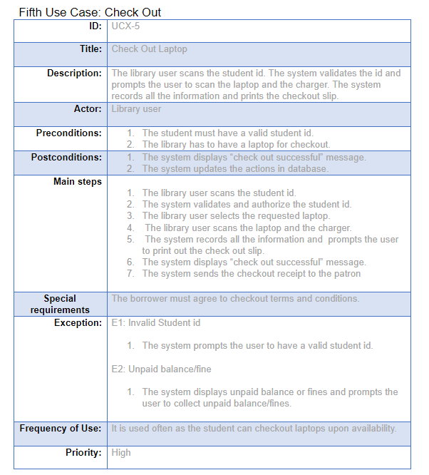
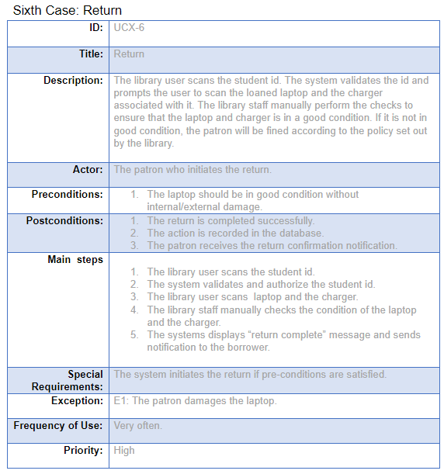
Use Case (Check Out / Return)

Slide 13
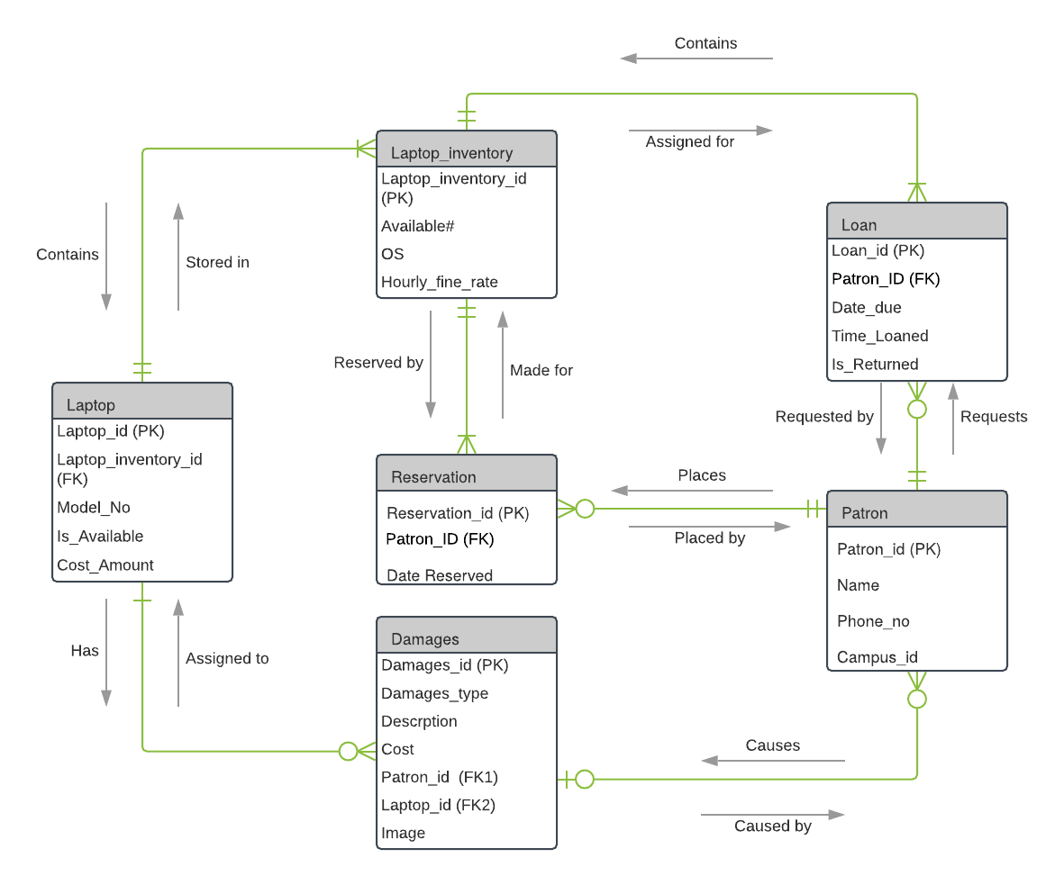
Third Normal Form Entity Relationship Diagram

Slide 14
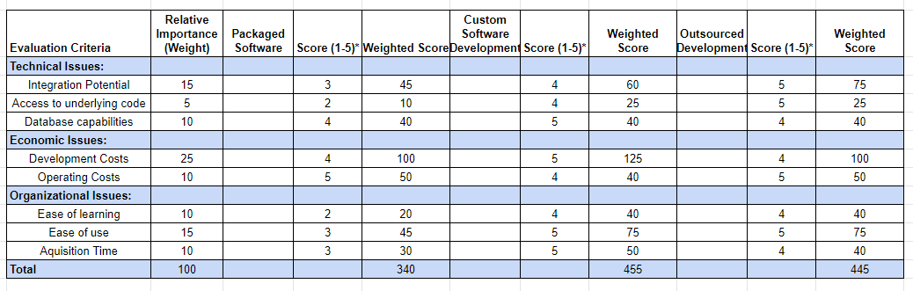
Individual Matrix 1

Slide 15
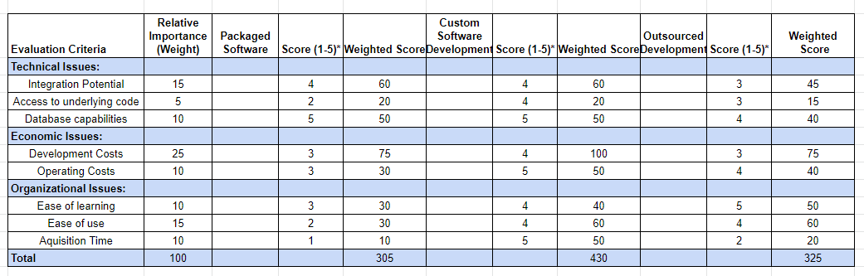
Individual Matrix 2

Slide 16
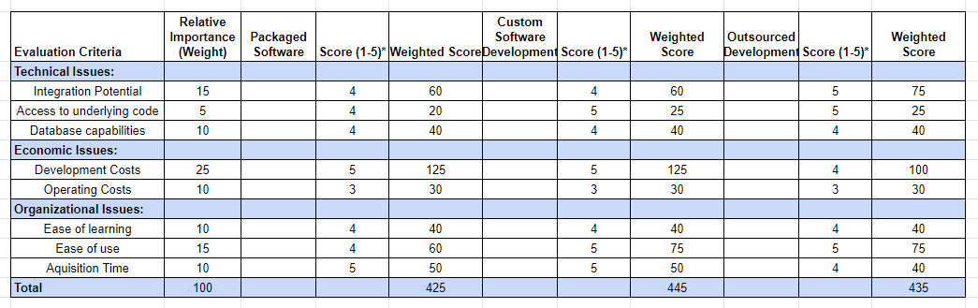
Individual Matrix 3

Slide 17
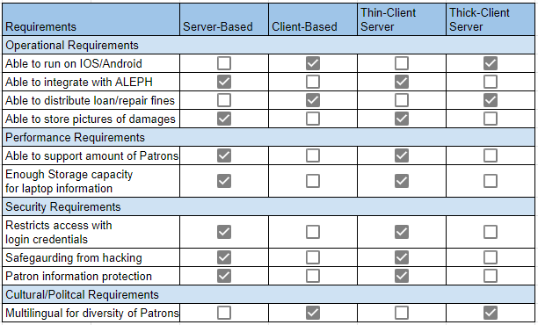
Architecture Matrix

Slide 18
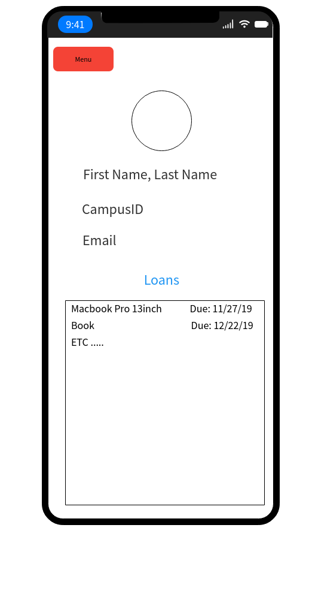
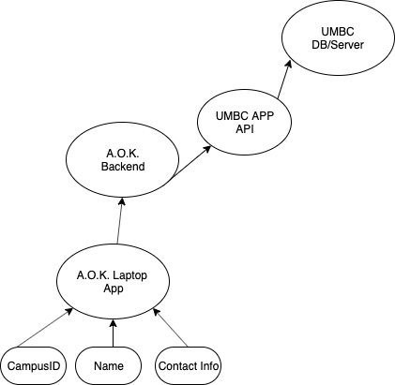
Integration with UMBC APP

Slide 19

Security requirements
Using UMBC app api will allow for greater security
Sensitive student information will not be stored locally
Passwords and contact information will be kept secure by having the data in a centralized location
With a server based architecture the IT department can manage and prevent unauthorized access

Slide 20
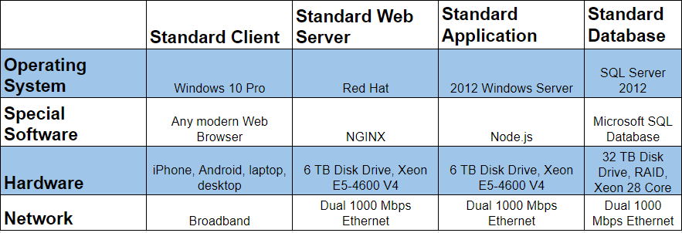
Hardware and Software Specs

Slide 21
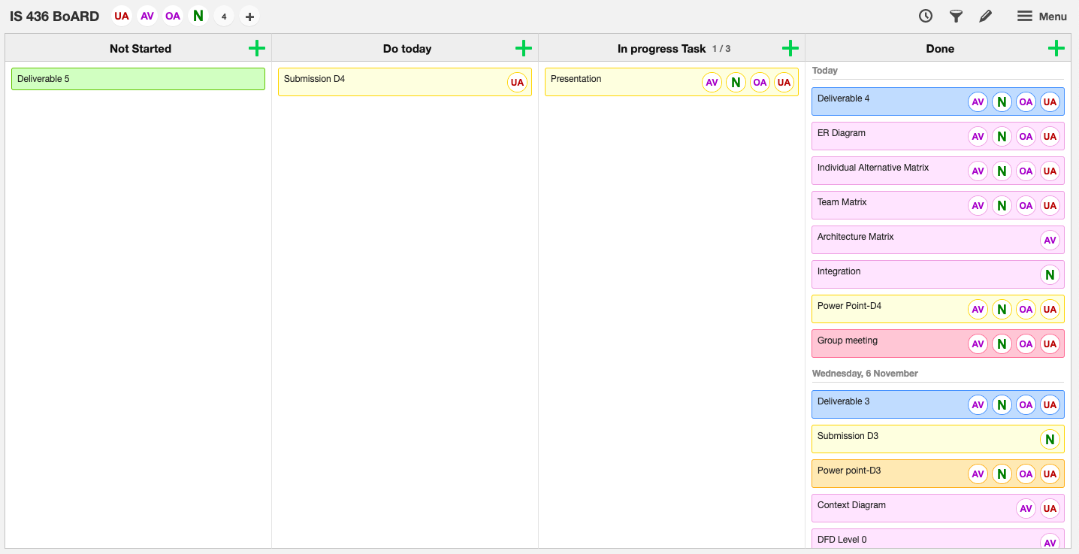
Kanban Board

Slide 22
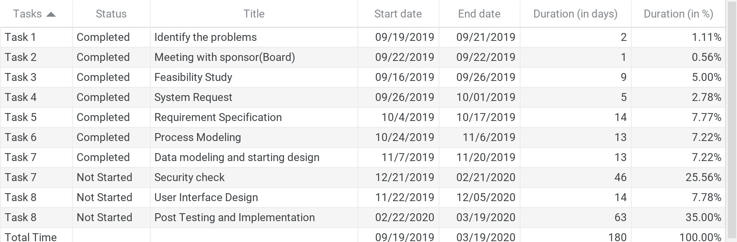
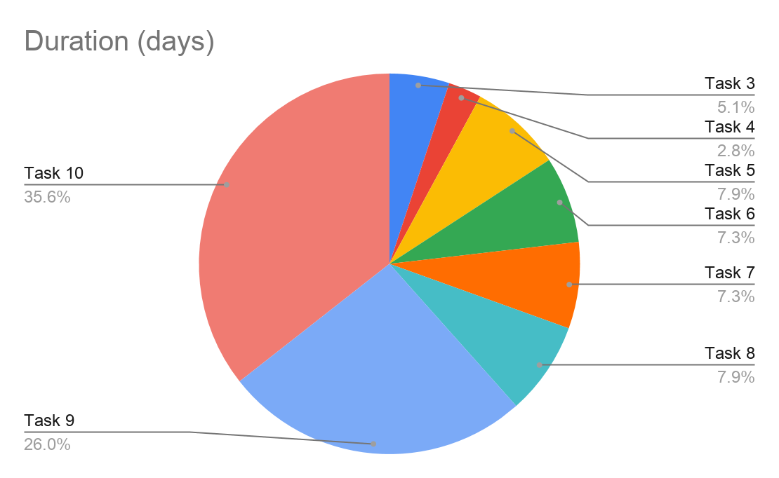
Project Plan

